Slide 1
INNOVATION
IN
TRANSPORTATION
BY
HEMARANJANI M
KHASHIKA S
LAVANYA V

Slide 2


PROBLEM STATEMENT
The Challenge: Revolutionizing Vehicle Safety and Communication with Innovative Solutions.The main goal of this challenge is to explore how cutting-edge technologies can be used to improve vehicle safety and communication. The ultimate aim is to redefine the way we interact with vehicles and ensure their safety.

Slide 3
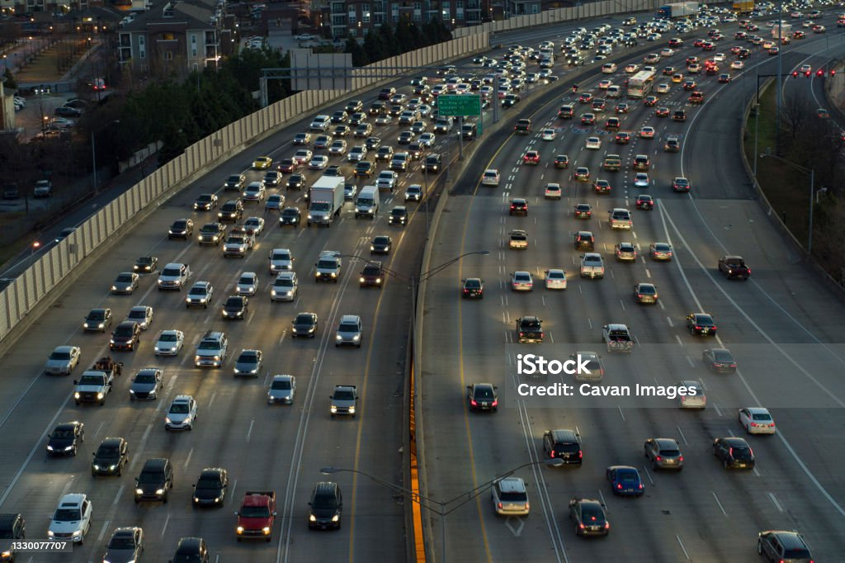

The integration of ultrasonic sensors into road safety systems represents a multifaceted approach aimed at enhancing safety and efficiency on the road.
These sensors are employed in vehicles and road infrastructure to prevent collisions, monitor blind spots, assist with parking, control vehicle speeds, and manage traffic flow intelligently.
Overall, the use of ultrasonic sensors in road safety offers a comprehensive and data-driven strategy to reduce accidents and enhance the transportation ecosystem's security and effectiveness.
IDEA OVERVIEW

Slide 4
The market prospects for integrating ultrasonic sensors into road safety systems are exceptionally bright.
Ultrasonic sensors, which help prevent collisions, monitor blind spots, and optimize traffic flow, are central to these efforts. Moreover, as the market for autonomous vehicles expands, the demand for these sensors continues to grow.
They play a crucial role in the development of self-driving cars, making them indispensable in the evolving automotive landscape.
As governments, industries, and consumers increasingly prioritize safety and smart transportation solutions, the market for ultrasonic sensor-based road safety systems is set to flourish.
MARKET PROSPECTS

Slide 5


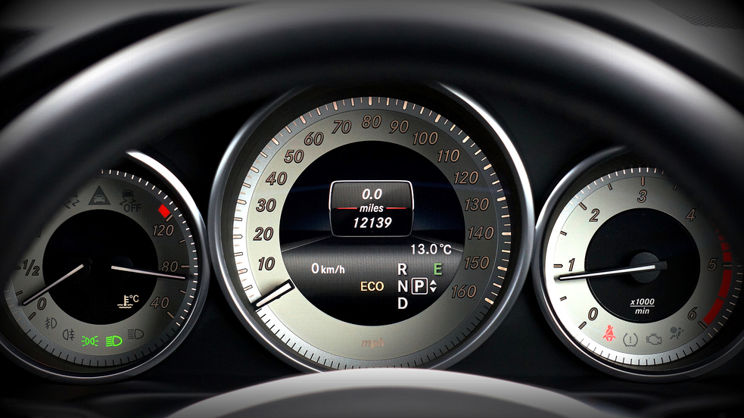
They will continue to play a pivotal role in autonomous vehicles, V2X communication, smart cities, and data analytics. These sensors will contribute to environmental goals, improve public transportation, and expand internationally. Consistent regulations, public awareness, and industry collaboration will drive their adoption.
The integration of ultrasonic sensors with other technologies will provide advanced safety measures, while infrastructure upgrades and an increasing focus on green transportation will fuel demand. Overall, ultrasonic sensors will be instrumental in ensuring safer and more efficient roadways in the future.
FUTURE SCOPE

Slide 6

TECHNICAL OVERVIEW
*Sensor Data Collection*: The IR and ultrasonic sensors continuously emit signals and measure the time it takes for these signals to bounce back. This data helps determine the distance between the vehicle and any obstacles.
*Data Processing*: The microcontroller collects and processes data from these sensors. It calculates the distance to the nearest obstacle in real-time.
*Obstacle Detection*: If the system detects an obstacle within a predefined danger zone (e.g., within a certain distance), it triggers the braking system.
*Braking Activation*: The microcontroller sends a signal to the braking system to activate it. This can be done electronically if the vehicle has an electronic brake control system, or it can be linked to the traditional brake pedal to initiate braking.

Slide 7


EXECUTION
step 1
Step 3
System Design for a Safety System:
Define requirements and objectives.
Identify necessary components like sensors, microcontroller, braking system, and power supply.
Create a detailed design and architecture.
Programming and Control:
Write the software code for the microcontroller to handle sensor data and control the braking system.
Implement algorithms to calculate distances and make real-time decisions based on sensor data.
Step 2
Step 4
Sensor Selection:
Choose high-quality IR and ultrasonic sensors suitable for your application.
Ensure that the sensors have the necessary accuracy and range for obstacle detection.
Safety Fail-Safes:
Include safety mechanisms that can handle unexpected scenarios, such as sensor failures or system glitches.
Ensure the system doesn't engage braking if there are no valid obstacles detected.

Slide 8
THANK YOU

